Slide 1


FILEMAN
RFID’s File Tracking System

Slide 2
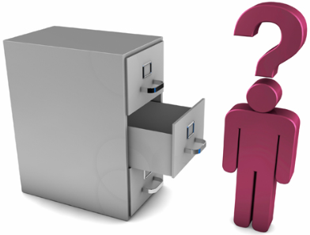
Preface
An organization which has public and financial dealings generates and obtains a large amount of valuable documents to be maintained for a very long time. Movement tracking and preservation of these documents is of prime concern Because these should not be misplaced or lost. The organizations which belong to this category are, for example, Banks, Insurance Companies, Finance companies and government departments. It is a difficult task to maintain and track these valuable documents manually or simply using computer software. The basic need is to capture the identity of a file/ document electronically to avoid human errors.

Slide 3
Challenges in the present system
•Inability to track documents within stipulated amount of time can have unfavorable impact on the business.
•Monetary and Legal implications in case legal documents are lost. It could also result in loss of goodwill, negative impact on brand equity and legal pursuits.
•Unproductive utilization of labor: Avoiding manual searching and sorting through cabinets save good amount of valuable employee time.
•Reduced customer satisfaction result when documents needed to service a Customer, cannot be traced/ found. At times, the lost/misplaced document took days to locate.
•Unable to identify the delay of file movement department wise /Employee wise .
• HOD is not having the full control on the status of file

Slide 4
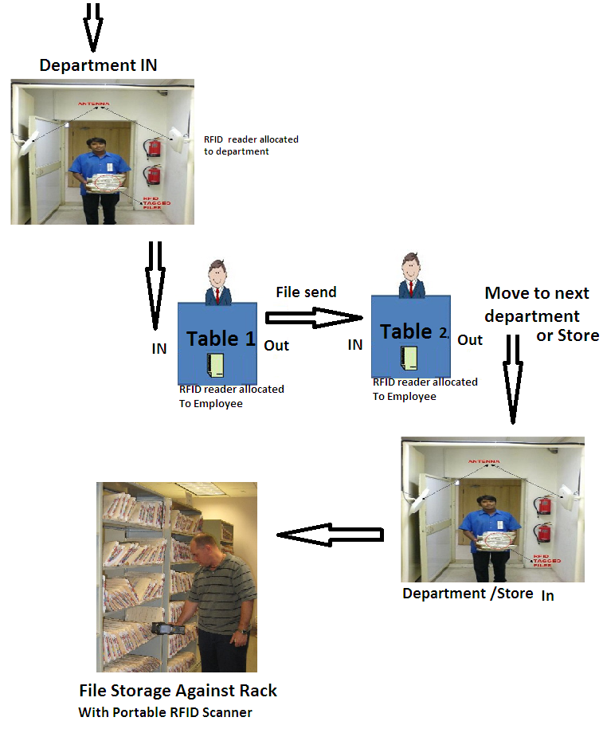
Proposed System

Slide 5
Major Process
File Registration & Tagging
Installing RFID Antenna at the Entrance/Exit Gate
Identification during Entry/Exit
File Transfer
Installing RFID reader in table of each employee
Identification during file In & Out
Physical Verification using Portable Reader in store
Finding a particular file using Portable Reader

Slide 6
File Tracking Features
File Registration & Tagging :
Every File need to be registered in the RFID based File tracking software. RFID tag with a unique serial number will be programmed in the software and will be attached to each File.
Installing RFID Antenna at Gate :
A long range RFID reader with TCP/IP interface will be installed at the Entrance/Exit door of the store. This reader will be connected to the server PC using the TCP/IP cable. Files(Tags) moving without approval will give alarm.

Slide 7
File Movement
Identification during Entry/Exit :
When the files moving one place to another place it should move through RFID gate, Reader will read the serial number of the tag and send to server , server will verify the serial number and the entrance/exit time will be recorded in the database.
File Transfer :
Every File need to be transfer using RFID USB reader and by using USB finger print device .Receiver will give the thumb impression for the receipt confirmation

Slide 8
Portable Reader for Searching the files
Portable data Terminal For Storage
A portable RFID reader will be used to read all files in a particular location after storing the file in the rack . RFID file numbers collected by the portable reader will be transferred to the server using WiFi or USB interface. Software will make stock reports .All bins will have an identification tag
Physical Verification using Portable data Terminal in store
A portable RFID reader will be used to read all files in a particular location. RFID file numbers collected by the portable reader will be transferred to the server using WiFi or USB interface. Software will make a comparison report showing any mismatches.
Finding a particular file using Portable data Terminal
ID of the file to be find will be inputted to a portable RFID reader. User will move near the files with the portable reader. Reader will read the file ids and when the reader reads the initially inputted file id, it will make an audible alarm.

Slide 9
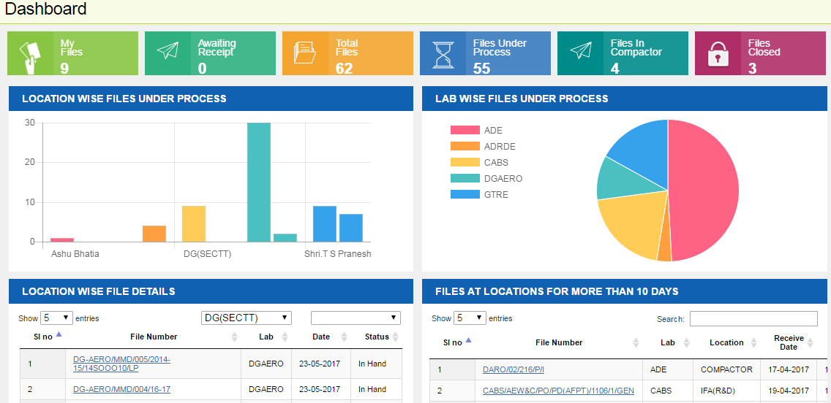
Screen Shot - Dashboard

Slide 10
Additional Customizations
Software Can integrate with existing Software to upload the master Entries
Multiple files can be linked with same file number and give separate tag ID’s
File movement of single file from linked files can be restricted
Alarm for file movement alarm in & exit gate with reader
Linking & Unlinking file option will be available

Slide 11
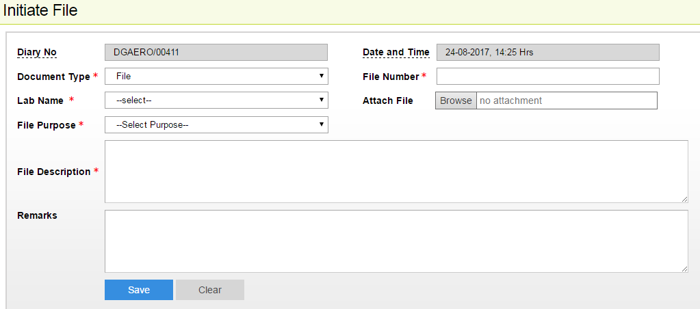
File Master

Slide 12
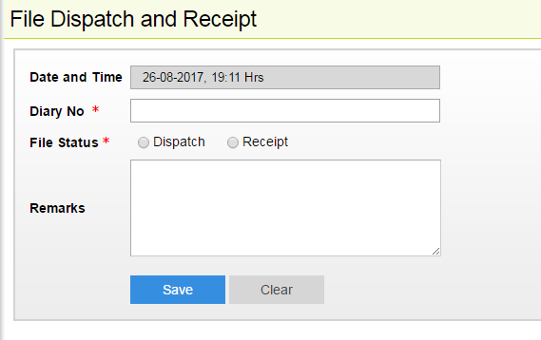
Transactions

Slide 13
Advantages
Accurate and automatic generation of file number so there no duplicate file name or no
Easley can identify the files on time so we can save the time.
Automated reports are instantly available in the server providing correct file name.
Automated system greatly reduces the scope for human error.
Reduction in manpower deployment.

Slide 14
Hardware Used for This Solution
RFID Tag 9640 – each file
Desktop reader – for Encoding tag and each table
RFID gate – Each entrance & Exit
Hand held Reader – for finding the file and stock tacking
Software – Report

Slide 15
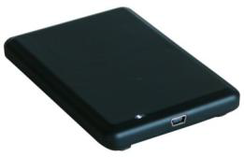
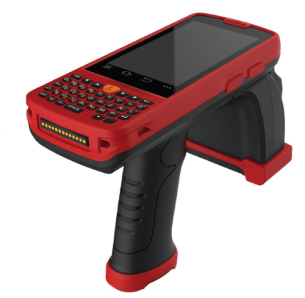

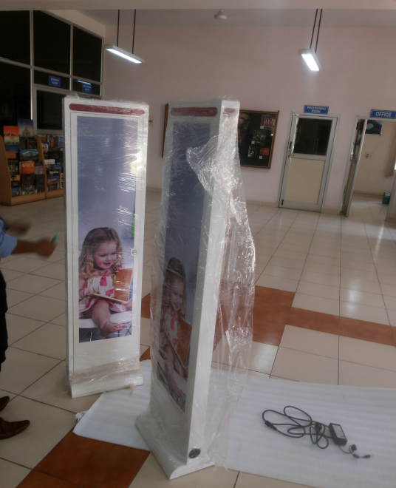
Hardware Used

Slide 16
FILEMAN
Thank You
Stallion Systems & Solutions Pvt. Ltd

